Slide 1
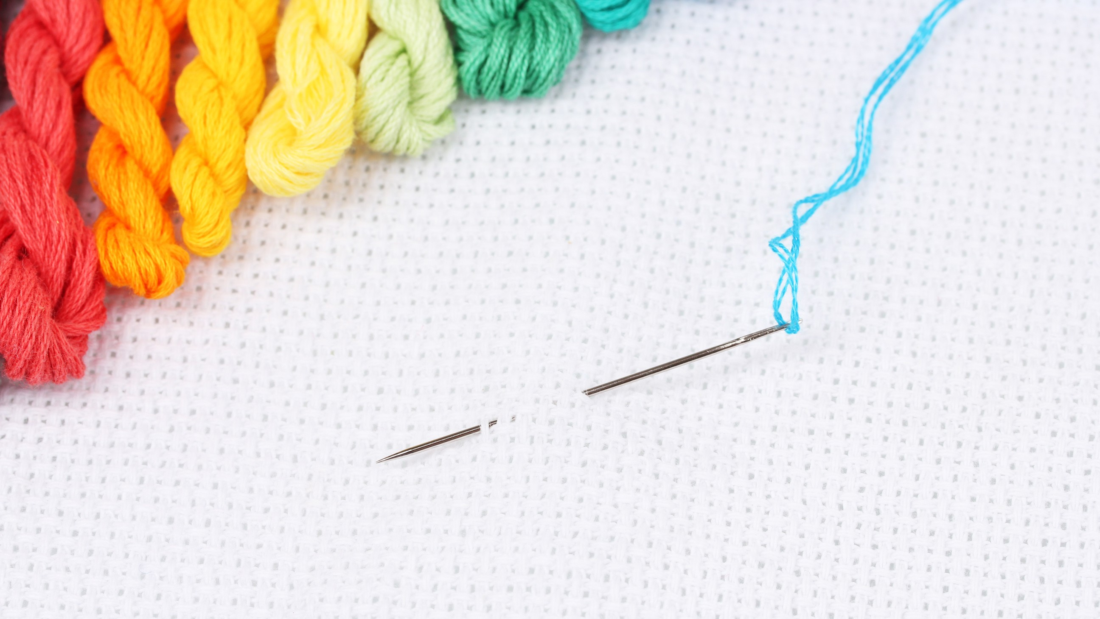


Slide 2
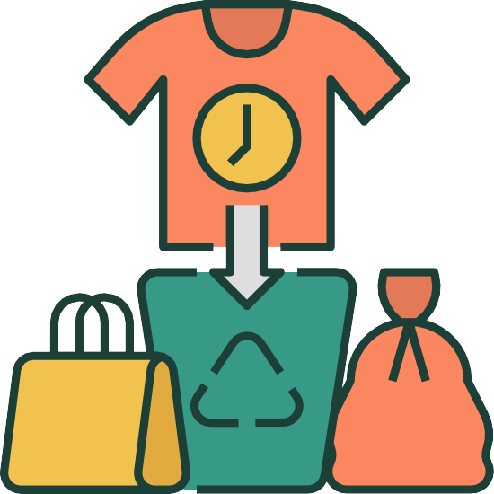

Problems Identified
Fast Fashion
Fast fashion promotes overconsumption and rapid turnover of clothing trends, leading to significant
environmental and social impact, including waste, pollution, and labor exploitation.
Lack of Job Opportunities for rural Women

Slide 3


BIG IDEA
We will collect unused clothes from households by reaching them through online laundry service and regular weekly moves. We will give them monetary incentives. Meanwhile, we will partner up with local NGOs to offer free handcraft manufacturing trainings to unemployed rural women who are our manufacturer.
Mission
We are on a mission to uphold the cultural heritage, discouraging fast fashion, empowering women, reducing fashion waste, and creating a sustainable fashion industry.

Slide 4

Business Model
Monetary Incentive
Per Kilo Package Value-Based Donation Exchange-Based
Clothes Collection
Incentivizing them will collect old clothes
Store house
Collected clothes will go
to our warehouse & will be cleaned there
Online Laundry
We will reach to the households through our laundry service
Partnership with local NGOs
Partnering-up with NGOs,
we will reach rural women and offer free trainings
Sales in B2C Model
We will sell our products in B2C model through our
website, social media platforms
Hand Manufacturing by women
Women will manufacture our products and give back to the NGOs

Slide 5

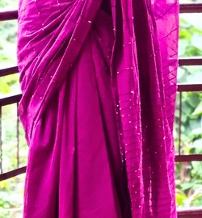

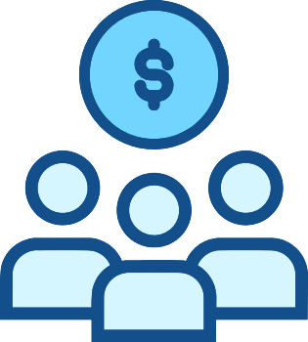
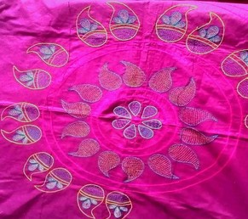

Supply Chain
Warehouse
Transport
Transport
J o u r n e y o f O u r P r o d u c t
Raw material
Women
Customer
Final Product
Warehouse

Slide 6

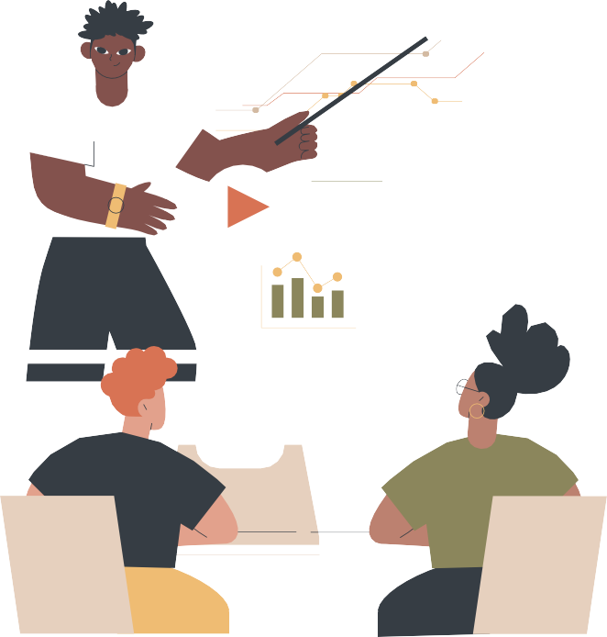

Innovation and Inclusion
Organizing virtual workshop
Customers Personal dashboard
ReTex's virtual workshops will provide valuable upcycling skills, fostering economic independence and empowering women for a brighter future."
Empowering customers with real-time insights, personalized recommendations, and seamless tracking for a delightful and
customized upcycling experience at ReTex."

Slide 7

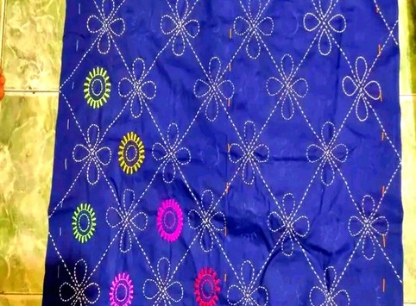
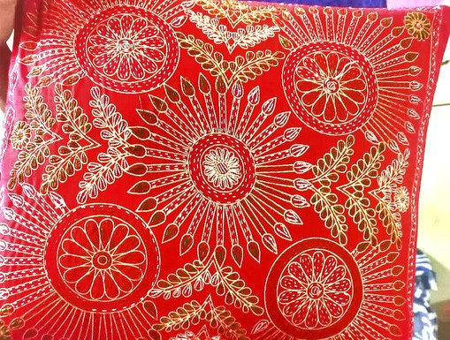
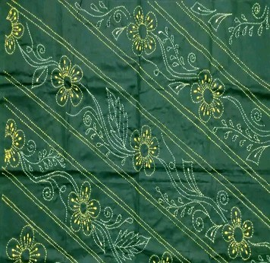
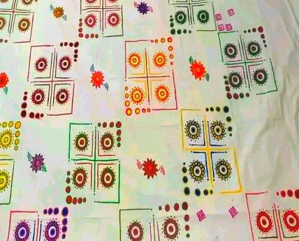
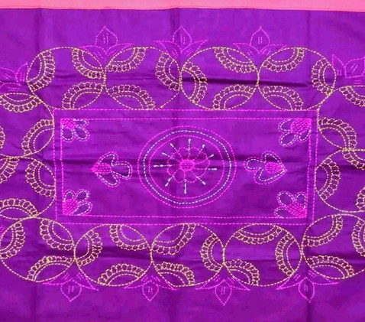
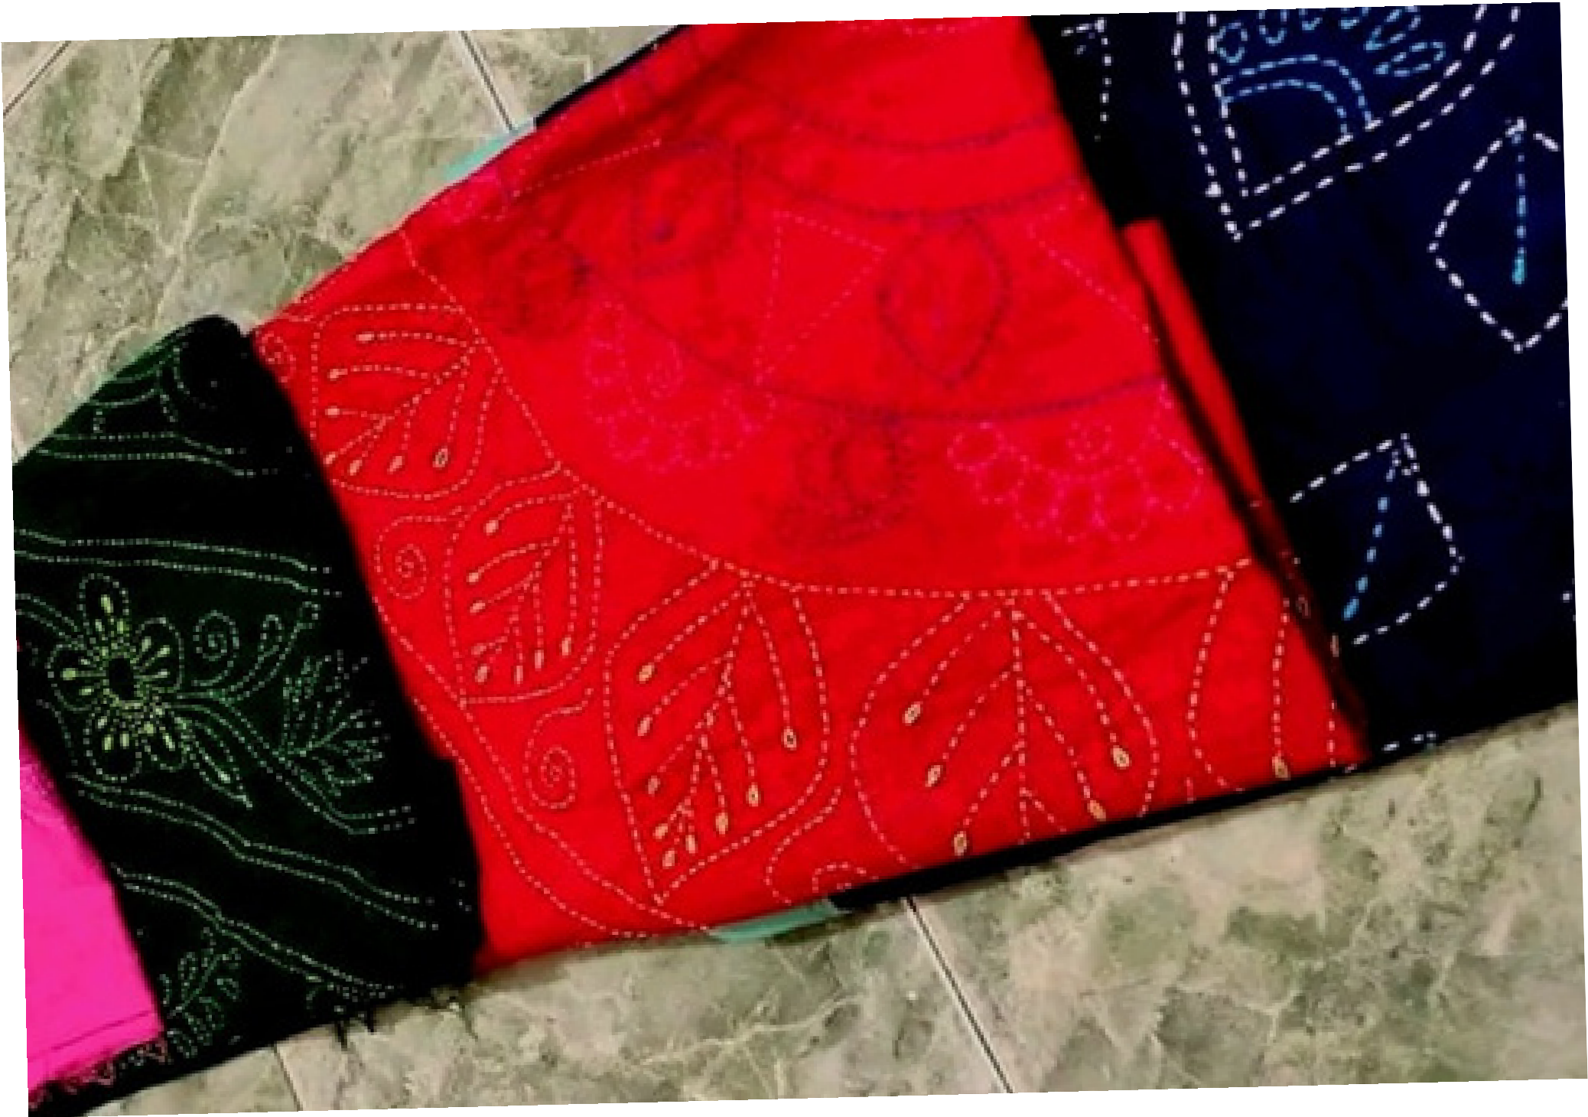
Products
Overview
Sharee
Pillow Cover
FEATURES OF OUR PRODUCT RANGES
Promoting sustainable fashion Carrying Heritage
Eco-Friendly Packaging
Hybridization of gender-based products
Nakshi Katha
Wall cloth
Nakshi Katha
Curtain

Slide 8


Impact
Reducing Waste
Giving old unused clothes back to life
Empowering Women
Developing skills of women and creating job for them
Promoting Sustainability
Discouraging Fast Fashion and encouraging using upcycled products
Encouraging Community Involvement
Creating an environmentally concerned community
Creating Unique Products
Creating a vast collection of unique products

Slide 9
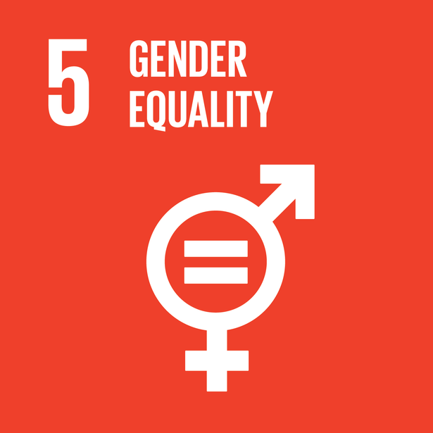
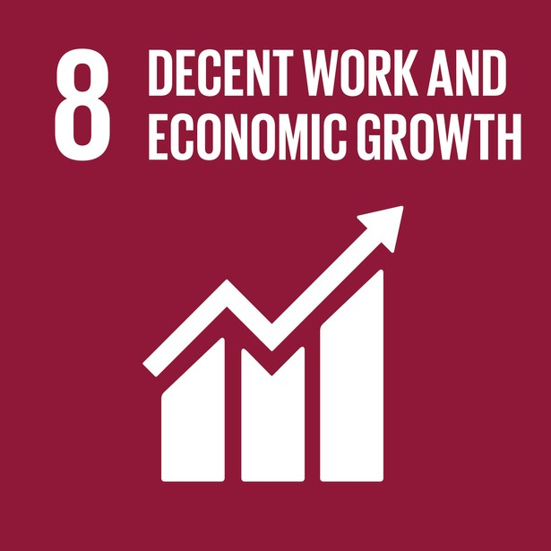
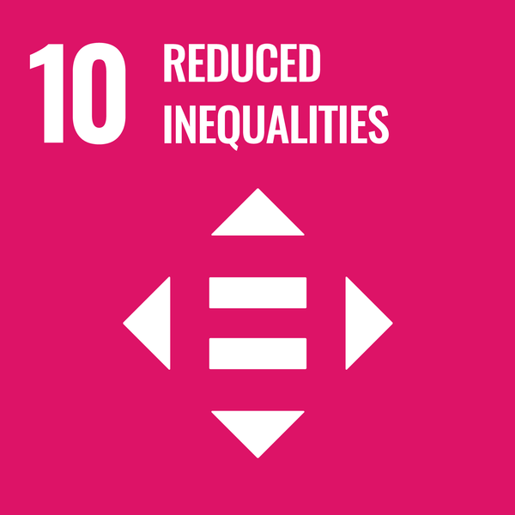
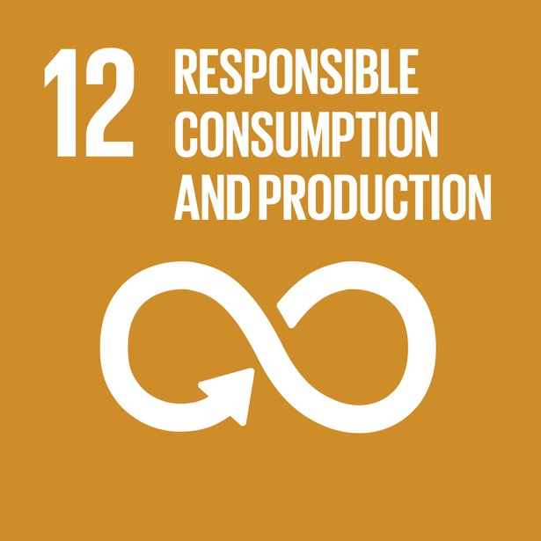
SDG Meetup

Slide 10
Finance
5
Duration | Cost | Revenue
6 Months | .96M | .816M
1 year | 1.92M | 1.68M
2 Years | 2.5M | 2.3M
4 Years | 2.7M | 2.835M
5 Years | 3.2M | 3.48M
6 Year | 3.5M | 4.1M
4
3
2
1
0
6 Mos
1 Year
2 Years
4Years
5Years
6 years

Slide 11
Return On Investment
6 Months
-15%
40%
1 Year
-12%
30%
20%
2 Years
-8%
10%
4 Years
5%
0%
5 Years
9%
-10%
15%
-20%
6 Years

Slide 12
Scalability
8000
6000
4000
2000
0
2022
2023
2024
2025
2026
2027
Outline
ReTex Established
Collaborate with NGO
Buy Transport
Expanding
Launching App service
Expand training program
Digital Equipment _{Product Range}
2 NGOs
3 type of sorting & printing machine
10+ design &
5+ different type products
ReTex app
10k+ women trained
Milestone

Slide 13


Pilot Result
Positive
The products are very comfortable with creative designs
78%
Product Review
Product range should be wider
22%
Negative

Slide 14
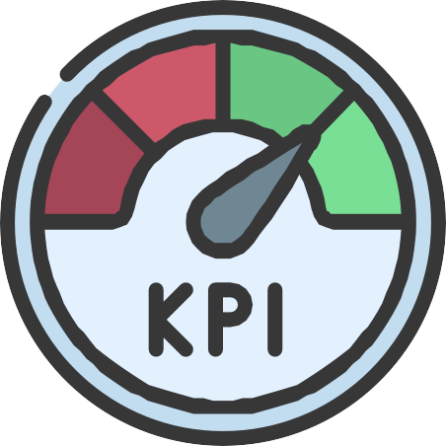
Key Performance Indicator
Raw material collection rate: We have collected around 50+ used old clothes as raw materials.
Upcycling Efficiency: Upcycled 30 products. For more efficiency, the process needs funding.
Sales volume: We have already sold 20 upcycled products.
Customer satisfaction: Received huge positive reviews from consumers.
Social and environmental impact: Employed 6 women who work from their homes.

Slide 15
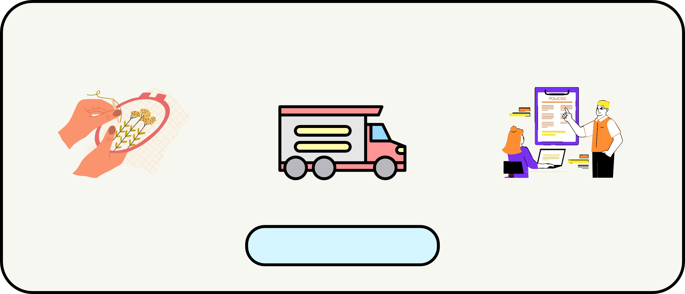
Product Market Fit
CHALLENGES IN CURRENT HANDCRAFT SECTOR
Lack of designers
Raw Material Crisis
Policy Support
Source: The Business Post, 2021
POTENTIAL IN THE SECOND-HAND APPAREL INDUSTRY
According to ThredUp Resale Report 2019, Second-hand will surpass Fast Fashion globally within the next 10 Years.
In 2020, Bangladesh exported $309k (being 93rd largest exporter) and imported $7.12M
(being 80th largest importer) in Used Clothing. (Source: oec.world, 2023)

Slide 16
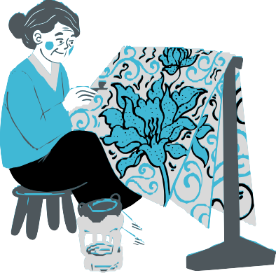
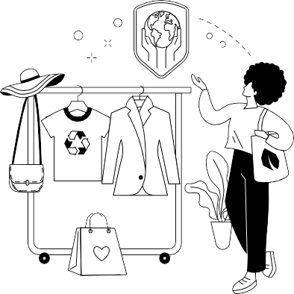

Competitors Analysis
Local Artisan
Fashion Brands
Don't have any concerns about social impact
Negative impact on environment & labour rights
Stronger focus on women empowerment & environmental impact
Personalized production process
Rely on mass production & outsourcing
Sustainable & eco friendly production process
No price scale
Higher price scale
Affordable price range
Packaging: Not Eco-Friendly
Packaging: Not Eco-Friendly
Eco-Friendly Packaging

Slide 17
Business Model Canvas
Key Partners
Key Activities
Value Proposition
Key Resources
NGO
Manufacturers Advisors
Women Skill Development Waste Reduction Branding & Promotion Product Sale
Products
Laundry & Repairing Service
Used Clothes as raw materials
Transport Equipment Storehouse
Cost Structure
Channels
Training Cost Equipment Cost Transportation Cost Raw Materials Cost
Per Kilo Package Value-Based Donation Exchange-Based
Revenue Stream
Website Mobile App
Selling upcycled products Online Laundry Service

Slide 18

Feasibility
Strong Demand: Growing demand for sustainable fashion products makes our business viable.
Low Barriers Entry: Low capital investment and minimal equipment needed for upcycling makes it feasible to pursue.
Social & Environmental Impact: focus on social and environmental impact can attract customers and investors interested in socially responsible businesses.
Scalability: Scalable business model allows to expand with growing demand.
Collaborative Partnership: Collaborative partnerships with local stakeholders can support and grow business

Slide 19
Financial Breakdown (Estimsted)
Monthly
(BDT)
20k 40k 20k
20k 20k 30k 10k 160k
Category
Raw Material
(Unused Clothes)
Transportation Warehouse
Maintanence
Marketing
Training Sessions Labor Wage Others
Total
Yearly (BDT)
240k
480k
240k
240k
240k
360k
120k
1.92M
Others 6.3%
Raw Material 12.5%
Training 12.5%
Transportation 25%
Labour Wage 18.8%
Marketing 12.5%
Warehouse 12.5%

Slide 20
Thank you!

